Slide 1
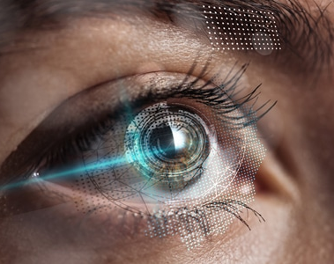
EyeTalk
An Accessible AAC Device Using Visual Speech

Slide 2
Challenges:
Fully disabled individuals (ALS, Paralysis, locked-in syndrome) lose the miracle of communication.
01
Existing solutions are often bulky and expensive.
02
Limited access to affordable communication technology in Egypt.

Slide 3
Solution:
Portable Eye-tracking system easily mounted on any moving chair.
01
Specialized software optimized for gaze interaction.
02
Real-time text to speech conversion.

Slide 4
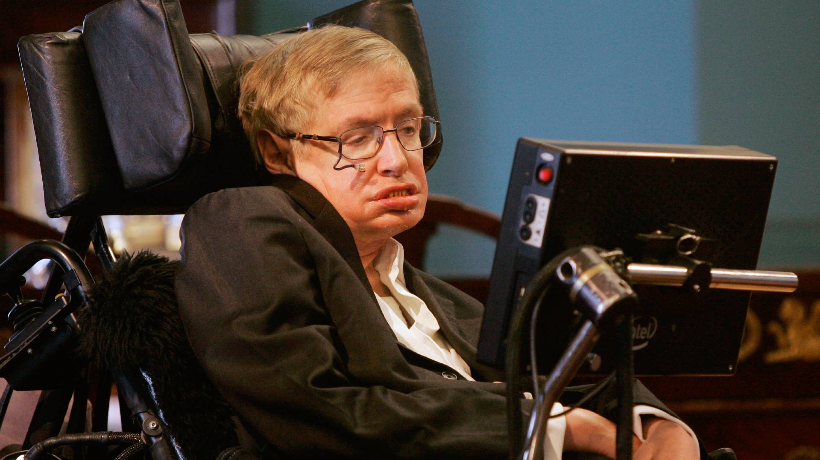

Slide 5
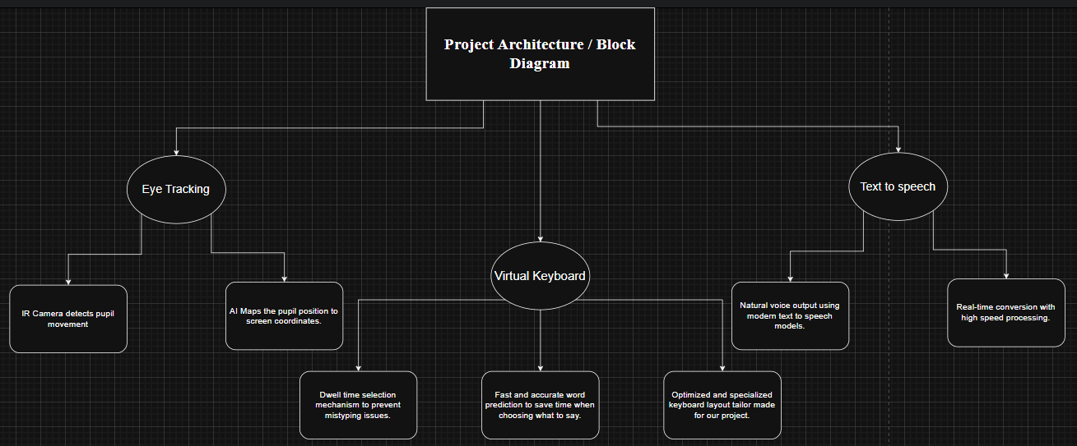

Slide 6
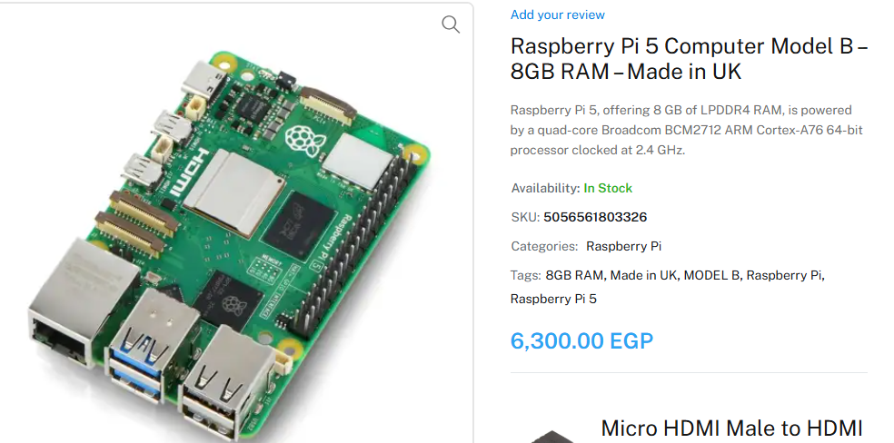
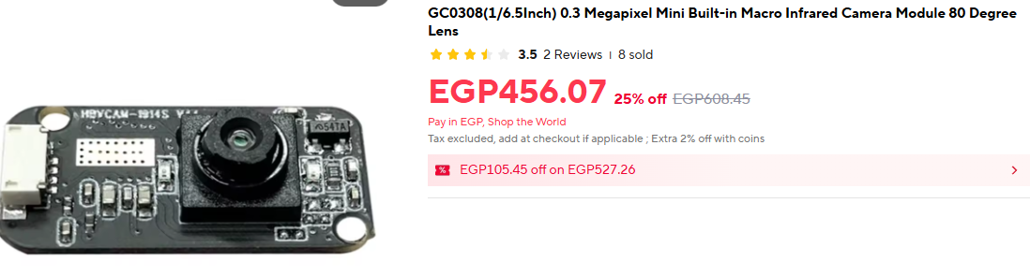
Hardware stack:
Raspberry Pi 5 8GB (Possibility of a more power processing unit if need be).
IR Camera Module (With NoIR filter).
Portable Power Bank or Portable Power Supply.
3D-Printed Design.
Total Cost: ~15000 – 20000 EGP

Slide 7
Camera Selection:
For Gaze tracking camera, there MUST be two things present:
  High camera sampling (atleast 120FPS).
  Assisting Infrared Lights (to dispel screen reflections from the eye retinas).

Slide 8
Team Learning & Researching Objectives:
Software Developers:
AI Developers:
Python 3.
PyQT, Modern Tkinter, Kivy.
Pytts and other related libraries.
Python 3.
Computer Vision (CNNs – Object Detection – Image Segmentation & other Techniques).
OpenCV.
Google Mediapipe (MAIN LIBRARY).

Slide 9
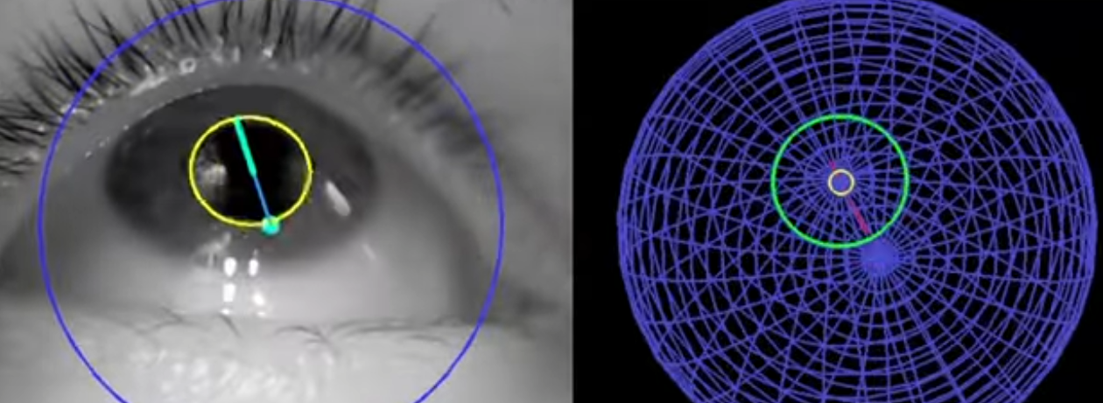
Google Mediapipe:
This model can track landmarks involving the iris, pupil and the eye contours using a single RGB camera, in real-time, without the need for specialized hardware. Through use of iris landmarks, the model is also able to determine the metric distance between the subject and the camera with relative error less than 10% without the use of depth sensor.

Slide 10
Team structure:
Software Developers
AI Developers
Fatma Ahmed Elawady
Hassan Abd Elsalam
Hagar Mohamed
Andrew Emad
Zyad Refaie Abu Alftooh (Software Leader)
Basel Mohamed Mostafa (AI Leader)
Hussein Hisham Ali
Mohamed Ahmed Abd Elnour
Abdullah Sayed Mohamed
Mariam Nashaat Bishry

Slide 11
Expected outcomes & Impact:
Technical Deliverables:
Working eye-tracking prototype
Optimized virtual keyboard software
Portable hardware unit
Comprehensive documentation
Social Impact:
Affordable communication solution
Open-source potential
Improved quality of life for users
Foundation for future enhancements

Slide 12
End of Lecture
Thank You

